Slide 1
GPP Exam: Zombie AI
Sam Stassijns

Slide 2
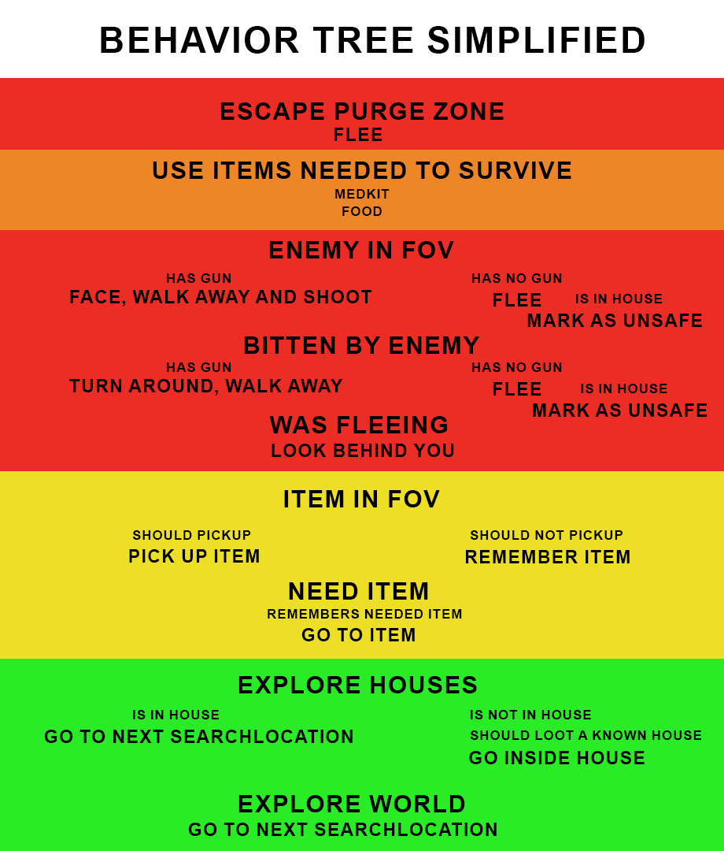
Decision Making
Danger
Item
Exploration
This is a simplification

Slide 3
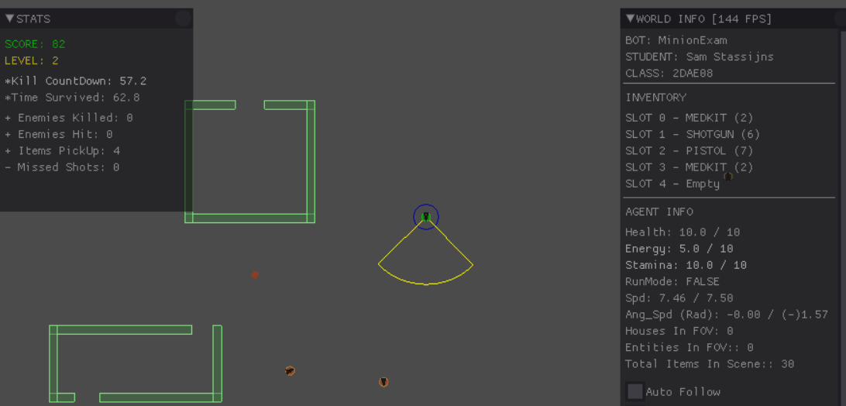
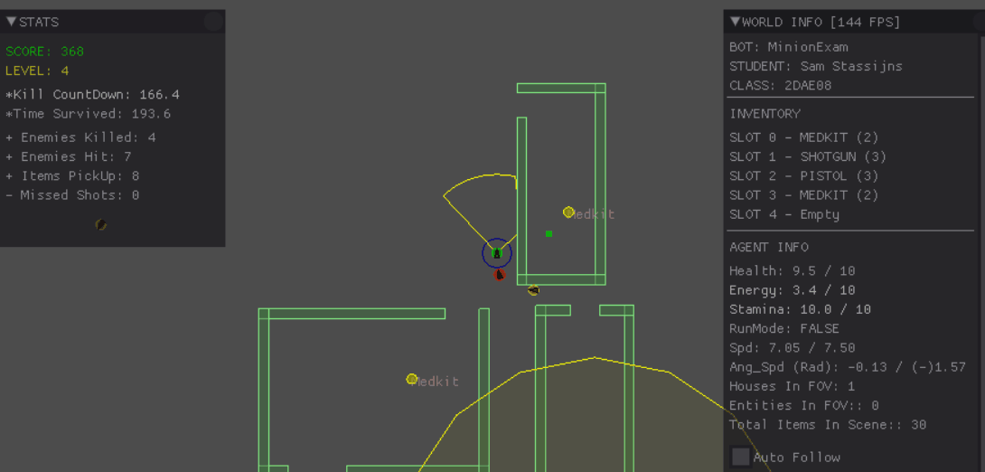
Enemy handling
Face, walk away and shoot
Turn around and shoot
Flee
Hide in safe house
Shotgun/pistol based on enemies

Slide 4
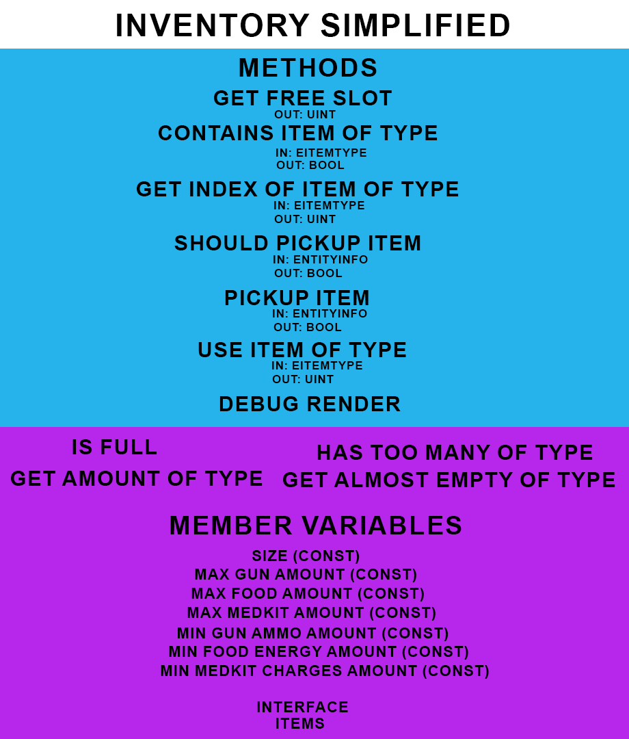
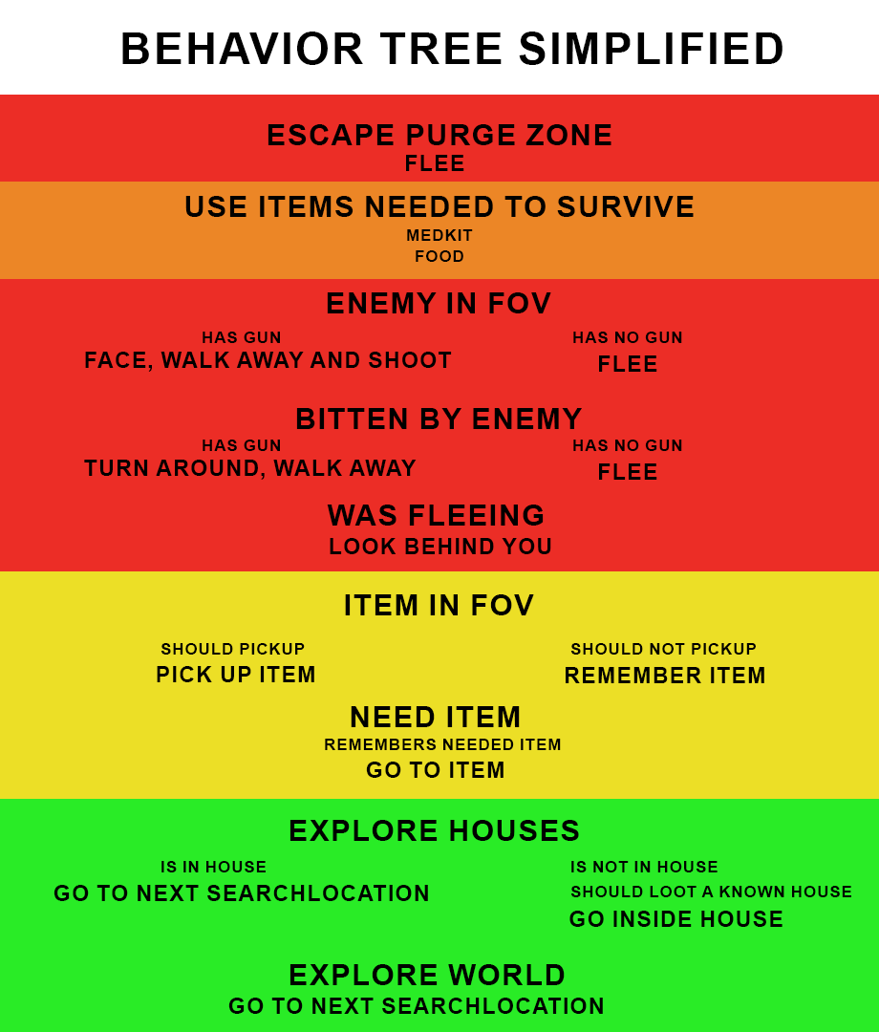
Inventory
Should pick up: amount of type ammo/charges/energy
Pick up: Remove garbage Remove from remembered
Remember: Save to blackboard

Slide 5
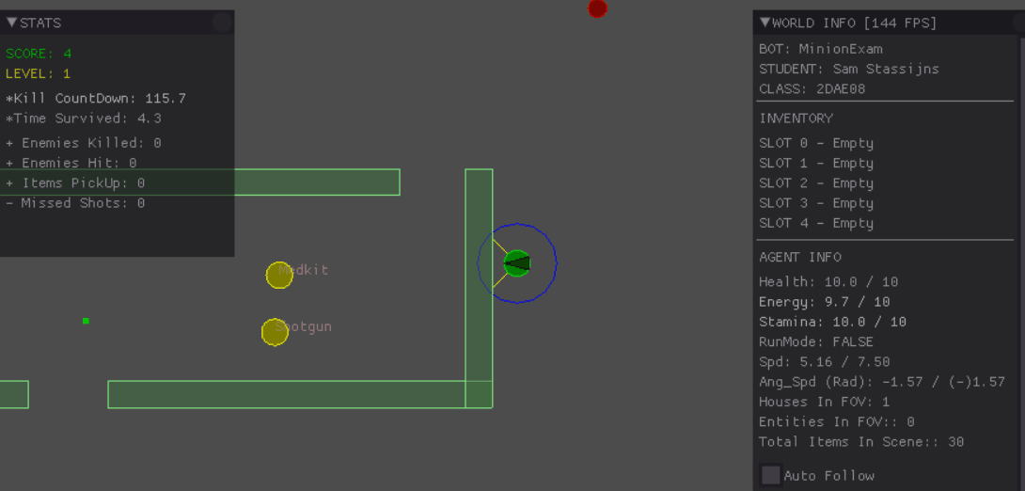
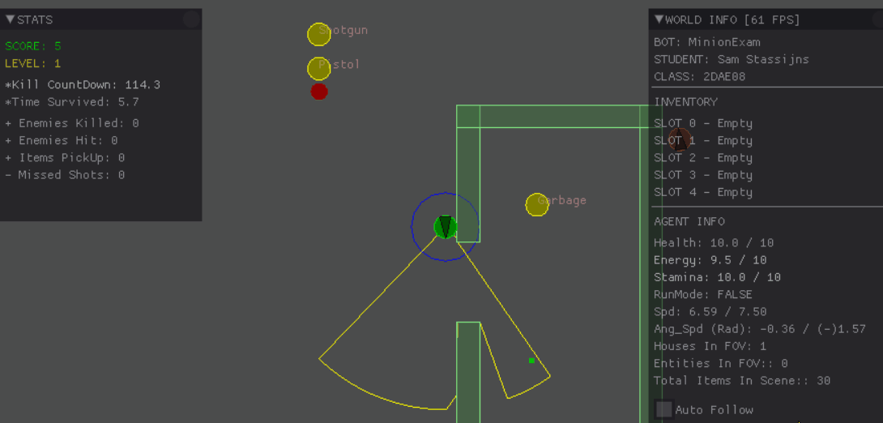
Movement & exploration
Known houses get saved Timer -> revisit
Rectangular world search
Seek, (Flee), Face, (Facebehind) While facing, linear velocity is kept

Slide 6
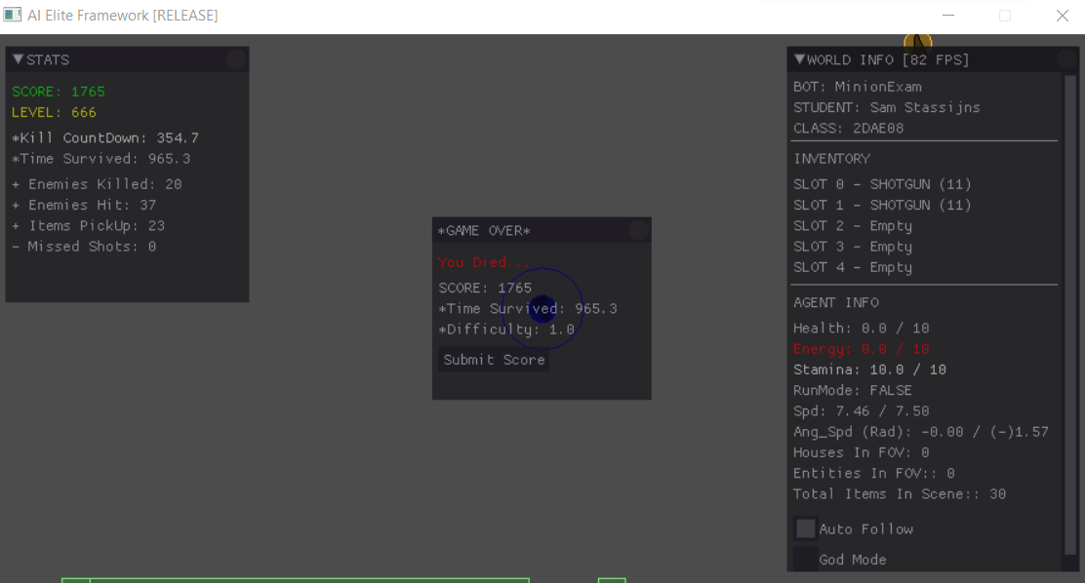
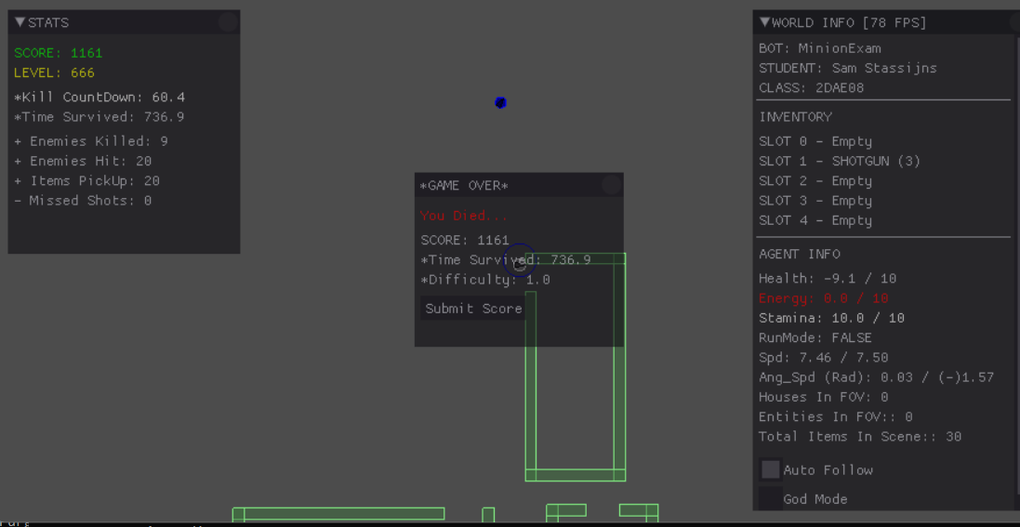
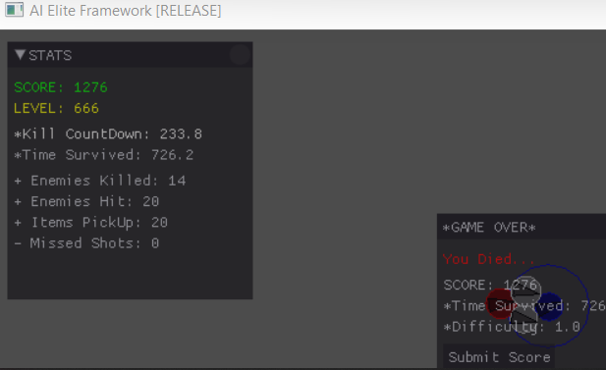
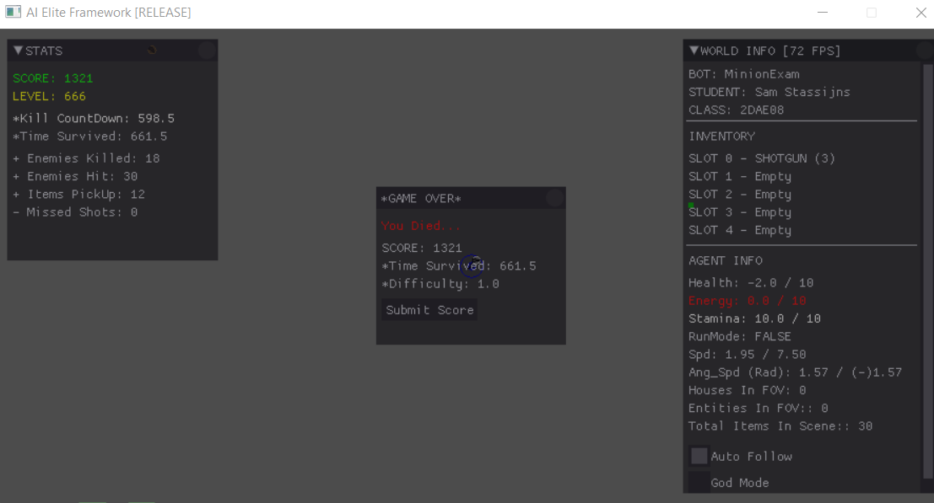
High Score

